Slide 1
Week 12b
COMPUTATIONAL MATHEMATICS
Finite Difference Method

Slide 2
Reference
Kisualaas, Jann. (2013). Numerical Methods in Engineering with Python 3. Cambridge University Press.
Johansson, Robert. (2015). Chapter 5. Equation Solving. Numerical Python: A Practical Techniques Approach for Industry, Apress.
Chapra, S. C., and Raymond P. Canale. (2010). Numerical methods for engineers, Sixth edition, McGraw Hill.
Kaw, A. (n.d.). Numerical Methods. Retrieved March 20, 2020, from https://nm.mathforcollege.com/

Slide 3


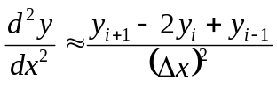
Finite Difference Method
An example of a boundary value ordinary differential equation is
The derivatives in such ordinary differential equation are substituted by finite divided differences approximations, such as
http://numericalmethods.eng.usf.edu

Slide 4





Example
Take the case of a pressure vessel that is being tested in the laboratory to check its ability to withstand pressure. For a thick pressure vessel of inner radius a and outer radius b, the differential equation for the radial displacement u of a point along the thickness is given by
The pressure vessel can be modeled as,
Substituting these approximations gives you,
http://numericalmethods.eng.usf.edu

Slide 5



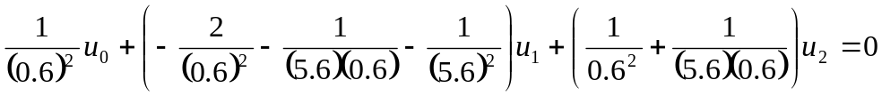



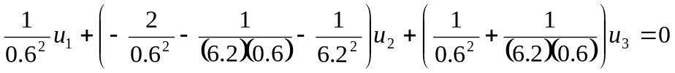

Solution
Step 1
At node
Step 2 At node
Step 3 At node
http://numericalmethods.eng.usf.edu

Slide 6





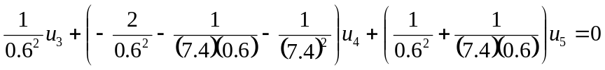



Solution Cont
Step 4 At node
Step 5 At node
Step 6 At node
http://numericalmethods.eng.usf.edu

Slide 7
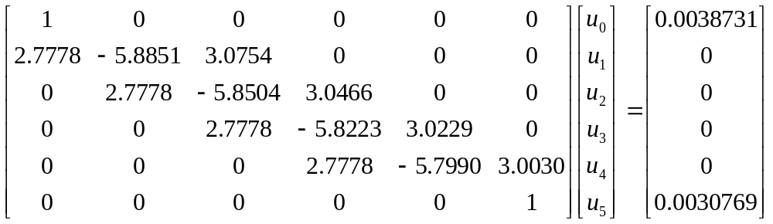






Solving system of equations
http://numericalmethods.eng.usf.edu

Slide 8



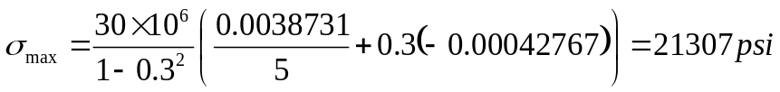
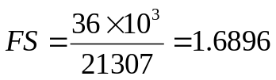


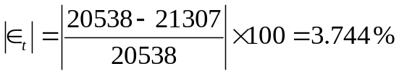
Solution Cont
http://numericalmethods.eng.usf.edu

Slide 9

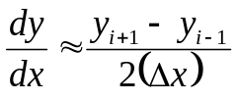
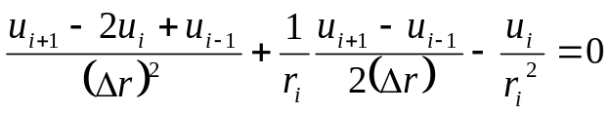
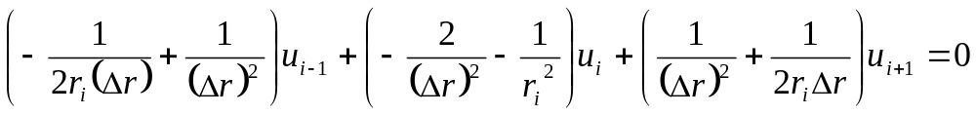
Solution Cont
Using the approximation of
and
Gives you
http://numericalmethods.eng.usf.edu

Slide 10



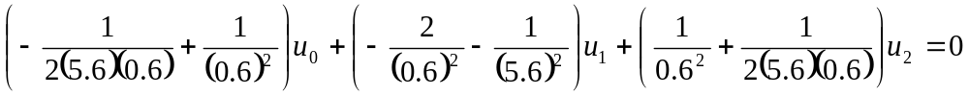


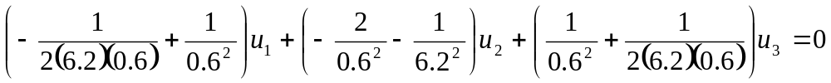

Solution Cont
Step 1 At node
Step 2 At node
Step 3 At node
http://numericalmethods.eng.usf.edu

Slide 11

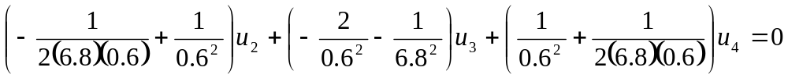


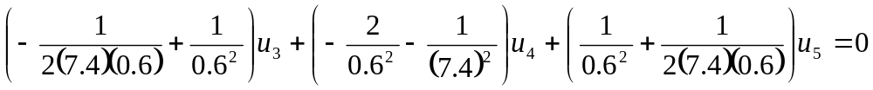



Solution Cont
Step 4 At node
Step 5 At node
Step 6 At node
http://numericalmethods.eng.usf.edu

Slide 12
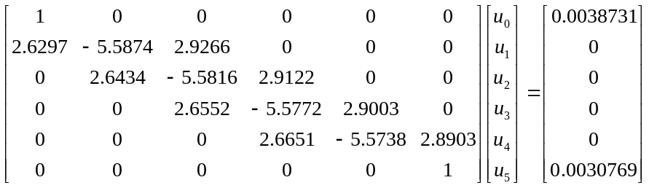




Solving system of equations
http://numericalmethods.eng.usf.edu

Slide 13
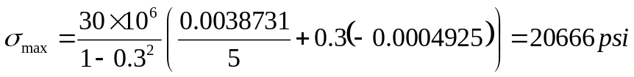


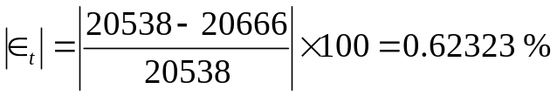
Solution Cont
http://numericalmethods.eng.usf.edu

Slide 14
Comparison of radial displacements
Table 1 Comparisons of radial displacements from two methods
r | u_{exact} | u_{1st order} | |є_{t}| | u_{2nd order} | |є_{t}|
5 | 0.0038731 | 0.0038731 | 0.0000 | 0.0038731 | 0.0000
5.6 | 0.0036110 | 0.0036165 | 1.5160×10⁻¹ | 0.0036115 | 1.4540×10⁻²
6.2 | 0.0034152 | 0.0034222 | 2.0260×10⁻¹ | 0.0034159 | 1.8765×10⁻²
6.8 | 0.0032683 | 0.0032743 | 1.8157×10⁻¹ | 0.0032689 | 1.6334×10⁻²
7.4 | 0.0031583 | 0.0031618 | 1.0903×10⁻¹ | 0.0031586 | 9.5665×10⁻³
8 | 0.0030769 | 0.0030769 | 0.0000 | 0.0030769 | 0.0000
http://numericalmethods.eng.usf.edu

